Slide 1

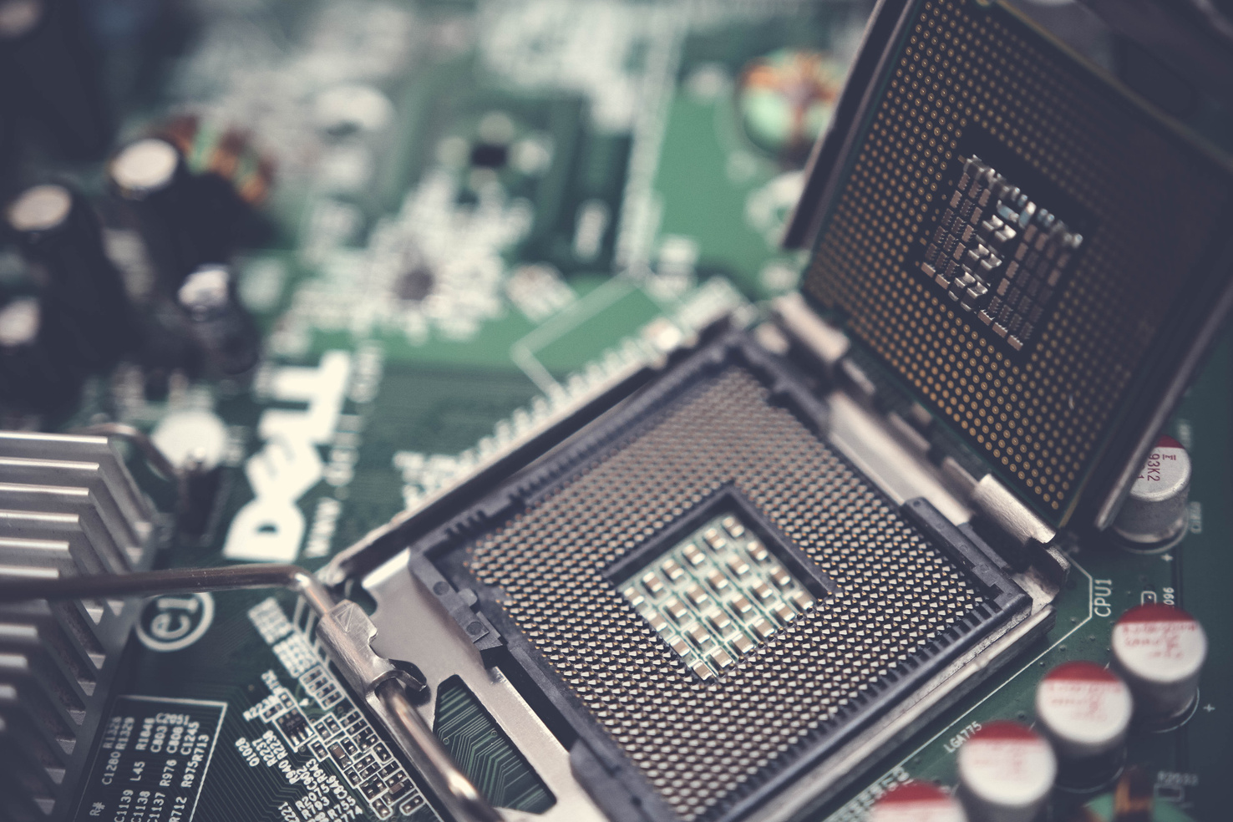
ENGLISH TO GERMAN
SPEECH TRANSLATOR
Subject - Microcontroller

Slide 2

Problem statement
From travellers to businesses, affordable speech translators bridge language gaps—choosing the right hardware and software stack is key to success!
Language barriers hinder effective communication in travel, business, and healthcare. This project solves this by building a low-cost, ESP32-based translator that converts spoken English to German in real-time using cloud APIs, balancing affordability and functionality

Slide 3
Project Overview:
This IoT-based English to German translator uses an ESP32 microcontroller with WiFi connectivity to create a web-based translation service. It features a local web server accessible through any browser, an OLED display for real-time feedback, and LED indicators for status updates. The system includes a comprehensive dictionary and can translate both single words and complete sentences. With physical controls and synchronized progress tracking, it demonstrates practical embedded systems and web technology integration for language translation applications.

Slide 4
Why ESP32?
The ESP32 (Espressif-32) is a powerful, low-cost microcontroller that can work for a cloud-dependent English-to-German translator. Here’s why it’s a strong candidate compared to Arduino Uno or Raspberry Pi:
Built-in WiFi Connectivity: ESP32 has integrated WiFi capabilities essential for hosting the web server and enabling wireless communication between users' devices and the translation system.
Dual-Core Processing Power: Its dual-core processor efficiently handles simultaneous tasks like web server management, OLED display updates, and translation processing without performance lag.
Rich Peripheral Support: ESP32 provides multiple GPIO pins to interface with the OLED display, LED indicators, and push button, while offering sufficient memory to store the extensive dictionary and web server code.
4. Low Power & Cheap:
Great for battery-powered devices (unlike Raspberry Pi).
Costs efficient/affordable
Best for cloud dependent translation.

Slide 5
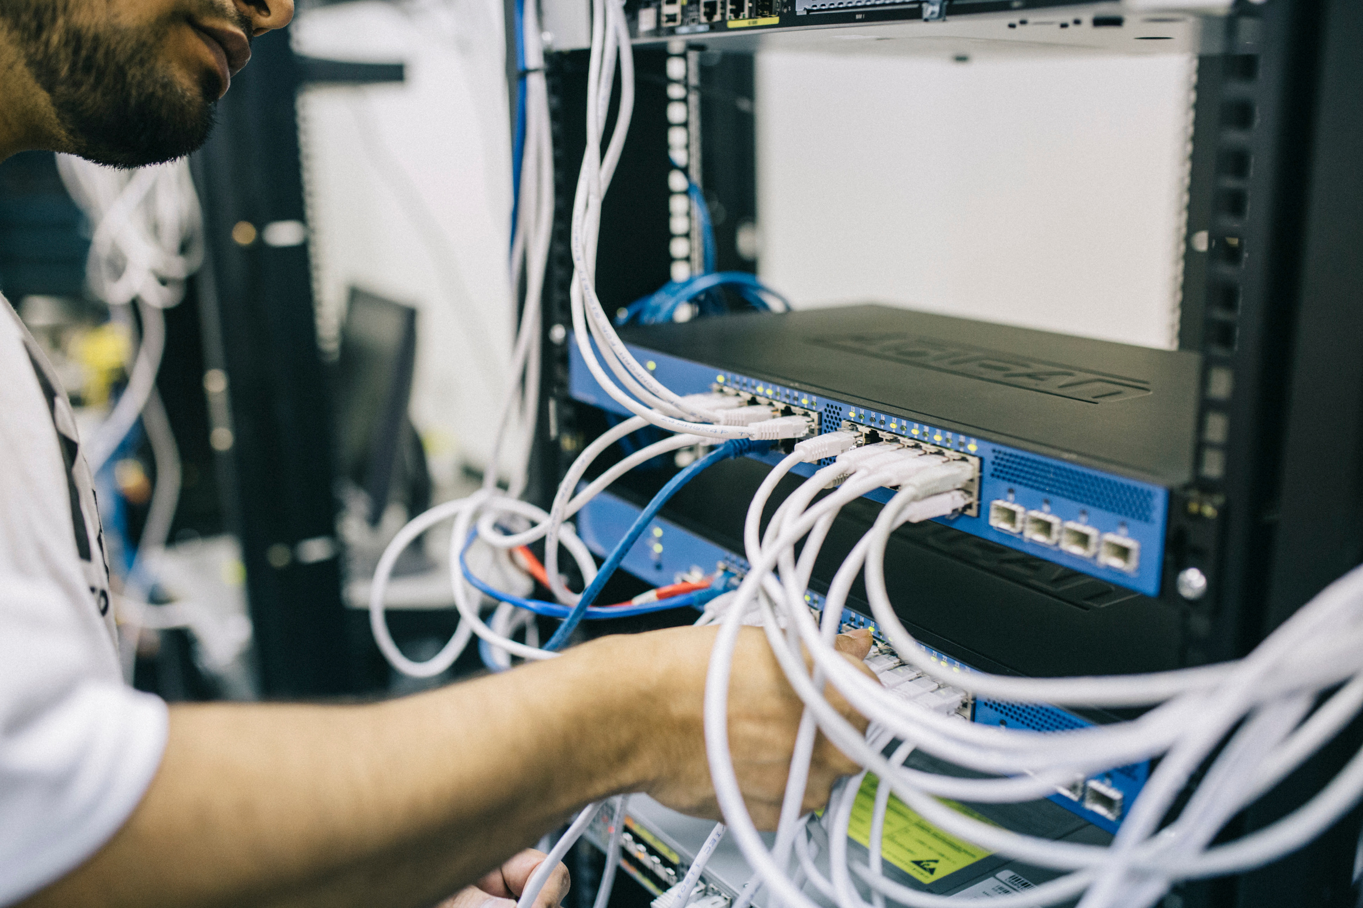
COMPONENTS USED :
ESP32 Dev Board (Handles Wi-fi and API connections) OLED Display 0.96”/ 128x64 LEDS- Red, Yellow & Green Resistors Buttons / Keypad Power supply (USB) Zero board Jumper wires

Slide 6
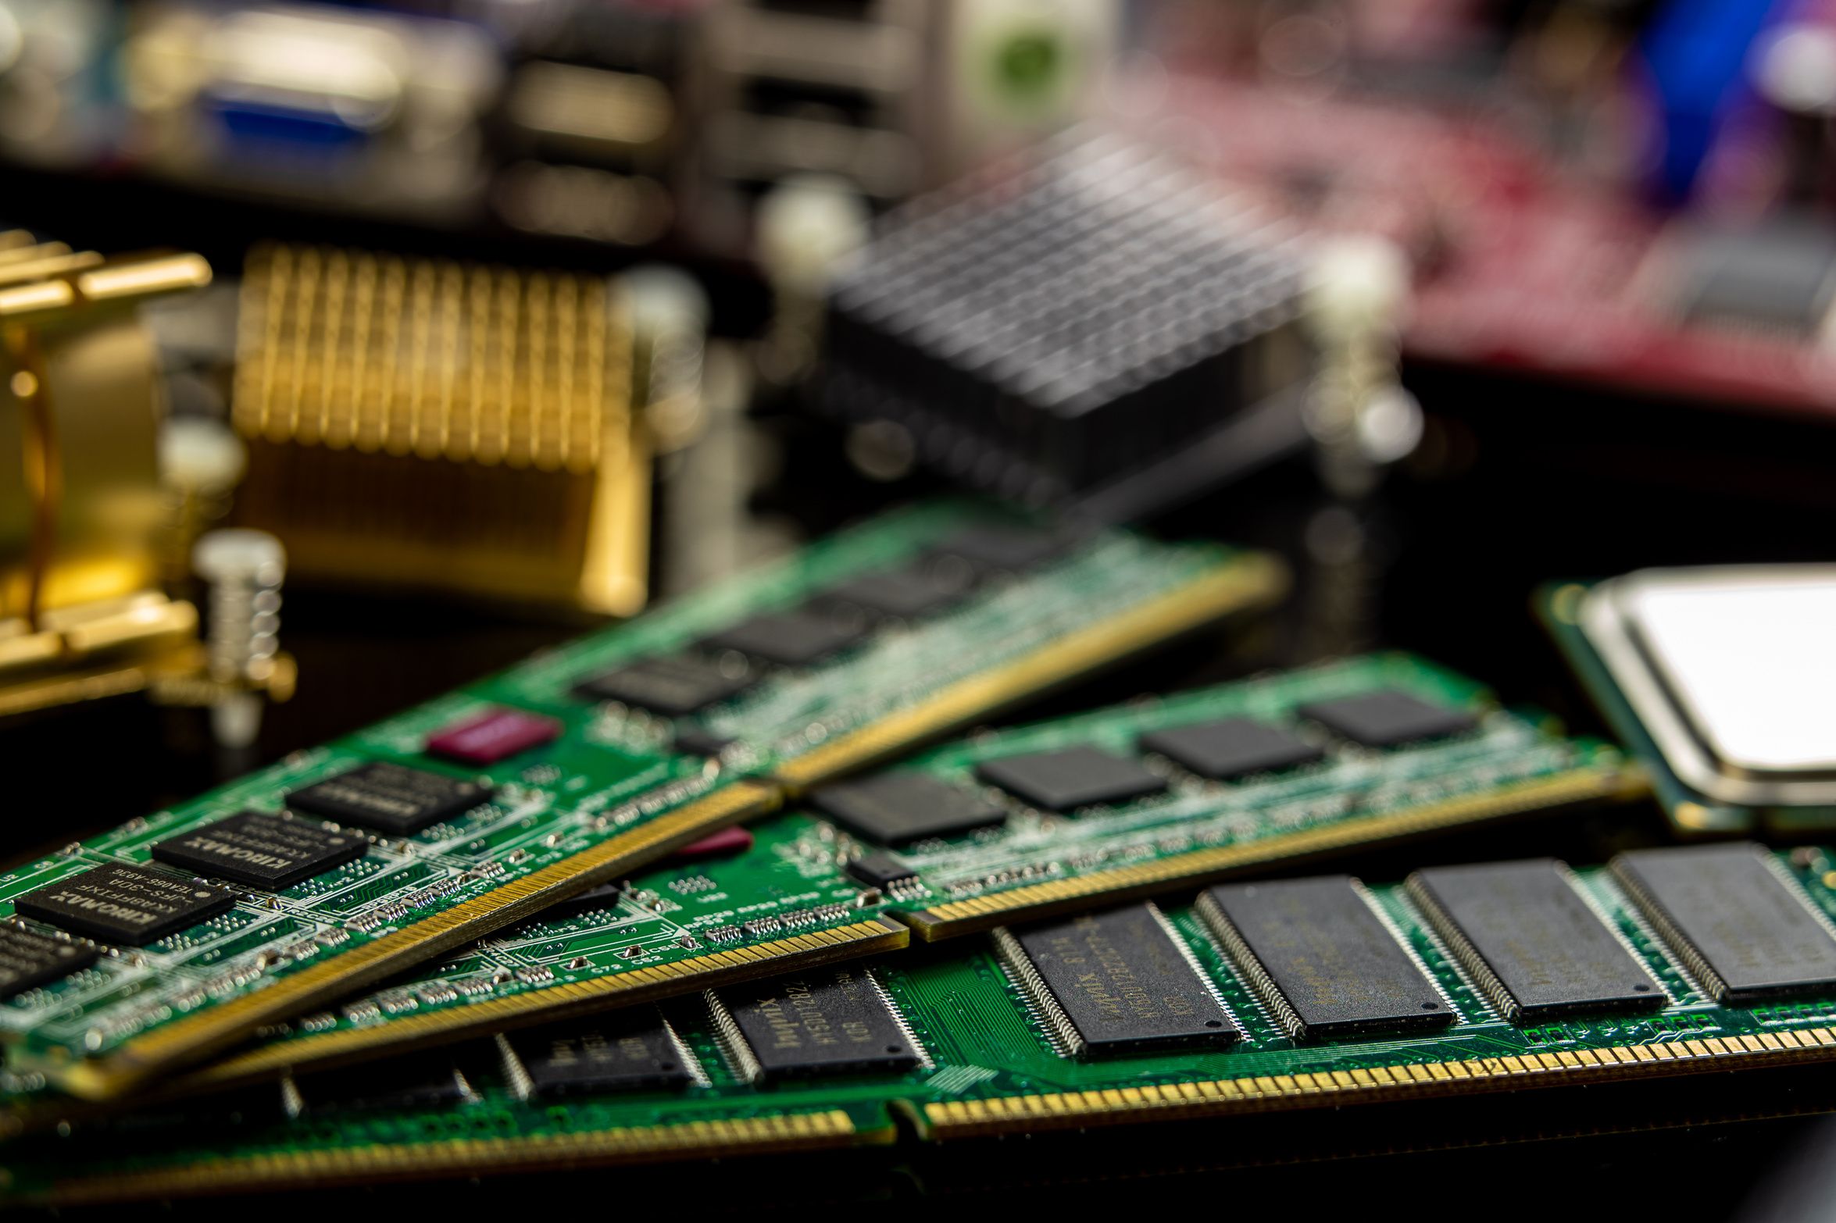
Working:
User Input - User enters English text via web browser WiFi Communication - ESP32 receives request through built-in web server. 2. Text Processing - System processes input, prioritizing multi-word phrases 3. Dictionary Lookup - Matches words/phrases with German equivalents 4. Progress Simulation - Shows an animated translation progress 5. Visual Feedback - OLED displays status; LEDs indicate translation phase 6. Output Delivery - Returns German translation to web interface 7. System Reset - Physical button clears current translation for new input

Slide 7
Real world applications
Travel & Tourism-
Use Case: Helps tourists communicate in German-speaking countries.
Example: Asking for directions, ordering food, or checking into hotels.
Language Learning-
Use Case: Assists students in practicing German pronunciation.
Example: Repeating phrases and getting instant feedback.
Healthcare-
Use Case: Aids doctors/nurses in multilingual patient interactions.
Example: Translating symptoms or medical instructions.
Emergency Situations-
Use Case: Quick translation for travelers in distress.
Example: Explaining emergencies to local authorities.
Smart Homes & IoT-
Use Case: Voice-controlled multilingual assistants.

Slide 8
Conclusion
This project demonstrates the feasibility of building a real-time English-to-German speech translator using microcontroller platforms, highlighting key trade-offs between performance, cost, and functionality. the ESP32 offers a budget-friendly, cloud-dependent solution with Wi-Fi connectivity. Cloud APIs provide high accuracy and natural-sounding voices but introduce latency, cost, and privacy considerations.

Slide 9
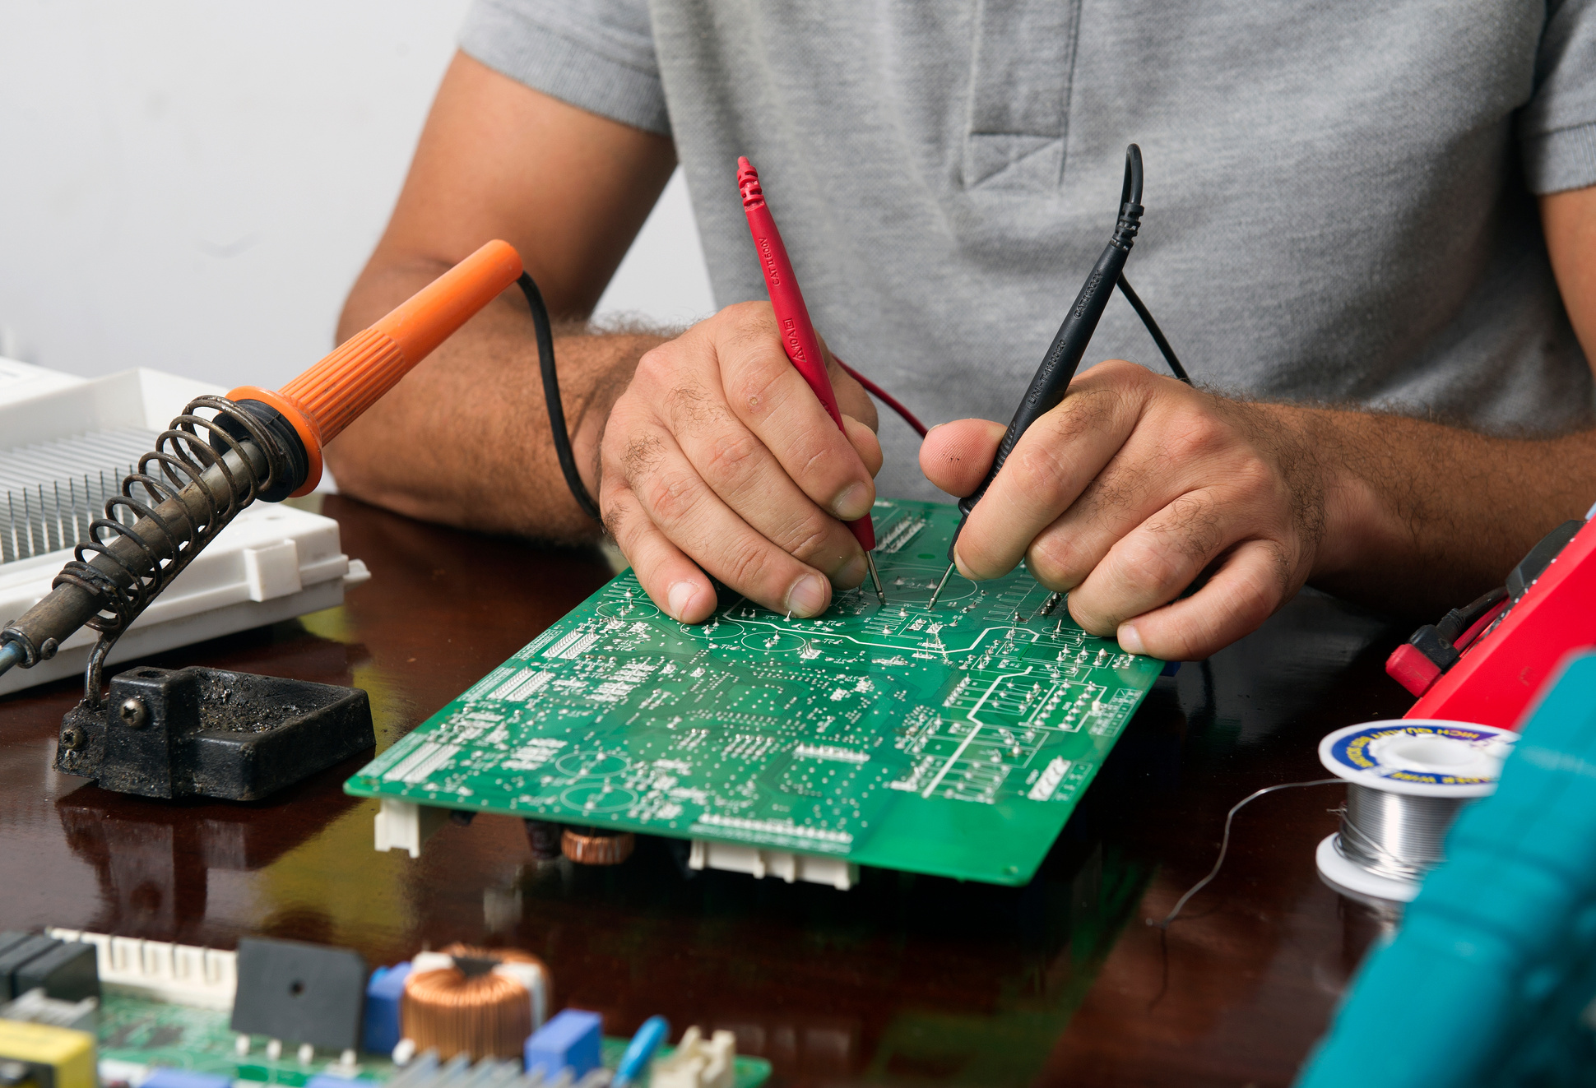
THANKYOU!

